Slide 1
A
PROJECT ON
S
I
G
N
LANGUAGE RECOGNITION SYSTEM
Akanksha Singh Karuna Dhruve Satyaprakash Dewangan
300102219003 300102219055 300102219087
Submitted By:

Slide 2
INTRODUCTION
The objective of this project is to identify the symbolic expression through images sp that the communication gap between a normal and hearing impaired person can be easily bridged.
Sign Language Recognition(SLR) system takes an input expression from the hearing impaired person gives output to the normal person in the form of text or voice.
For the communication among deaf and dumb people is carried by text and visual expressions.
Gesture communication is always a scope of confidential and secure communication.

Slide 3
AMERICAN SIGN LANGUAGE (ASL)
A
S
L
American Sign Language (ASL) recognition involves developing systems and technologies that can understand and interpret sign language gestures used by the deaf and hard-of-hearing community.
It is a complete and natural language with its own unique grammar, syntax, and vocabulary.
Handshapes, facial expressions, and body language are integral components of ASL communication.
.

Slide 4
IDENTIFYING THE PROBLEM
Understanding sign language using machine learning and deep learning
Lack of resources to understand sign language
Limited accessibility for deaf and hard-of-hearing individuals
Difficulty in communication for sign language users
There is a shortage of resources available to teach sign language to non-signers, making it difficult for them to understand it.
There is limited accessibility for deaf and hard-of-hearing individuals, creating communication barriers in various settings.
Sign language users face difficulty in communication with non-signers, leading to misinterpretations and misunderstandings.

Slide 5
APPROACHES TO SIGN LANGUAGE RECOGNITION
Vision-based
Sensor-based
Hybrid
It is approaches that use cameras or depth sensors to capture and analyze hand gestures.
Sensor-based approaches that utilize wearable devices to capture hand movements and patterns
Combination of vision and sensor to recognize signs is best and most accurate solution

Slide 6
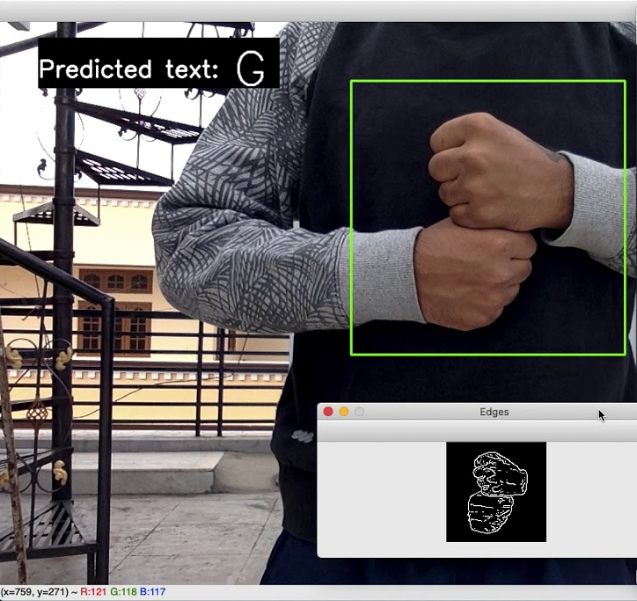
OUR APPROACH
Vision Based Approach
Sign language recognition using a vision-based approach involves the use of computer vision techniques to interpret and understand sign language gestures from video or image data.

Slide 7
4 STEP INFOGRAPHIC
Implementation
Research and development
Implementing the model by taking input from the webcam and recognize the signs using this model
04
01
Conducting research and development to explore the potential of each solution
Algorithm development
Data collection and annotation
Developing machine learning algorithms for sign language recognition
03
02
Collecting and annotating sign language data to train machine learning algorithms

Slide 8
SIGN ALPHABETS
A
B
C
D
E
F
G
H
I
J
K
L
M
N
O
P
Q
R
S
T
U
V
W
X
Y
Z

Slide 9
DATASET
21 signers recruited by the Deaf Professional Arts Network provided the sign. They are from many regions across the United States and all use American Sign Language as their primary form of communication. This dataset contains the data of sign of 250 words.
Kaggle ASL Dataset

Slide 10
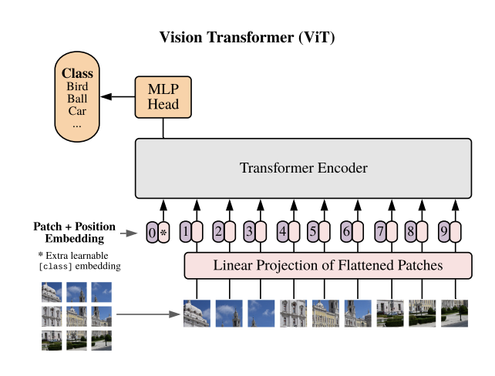
VISION-TRANSFORMER MODEL
Adapting Vision Transformers for sign language recognition involves segmenting the hand region and encoding the temporal sequence of hand gestures using the Vision Transformer architecture. This approach allows the model to effectively capture spatial relationships and long-range dependencies, leading to accurate interpretation of sign language gestures. Further research and development in this area hold promise for improved accessibility and communication for individuals using sign languages.

Slide 11
MODEL ACCURACY
100% on Train Data
99% on Validation Data

Slide 12
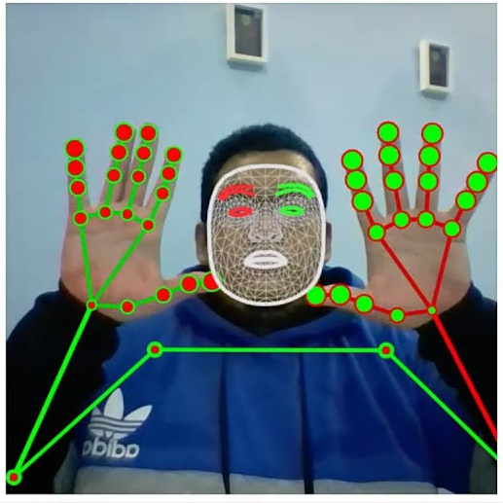
IMPLEMENTATION
OpenCV
Prediction
It is used to get webcam feed from user
Predict the word by processing the landmarks from the trained model
MediaPipe
Desired Use
Each frame is processed through mediapipe to extracts the face, pose and hand landmarks of the user
Any use can then use this data

Slide 13
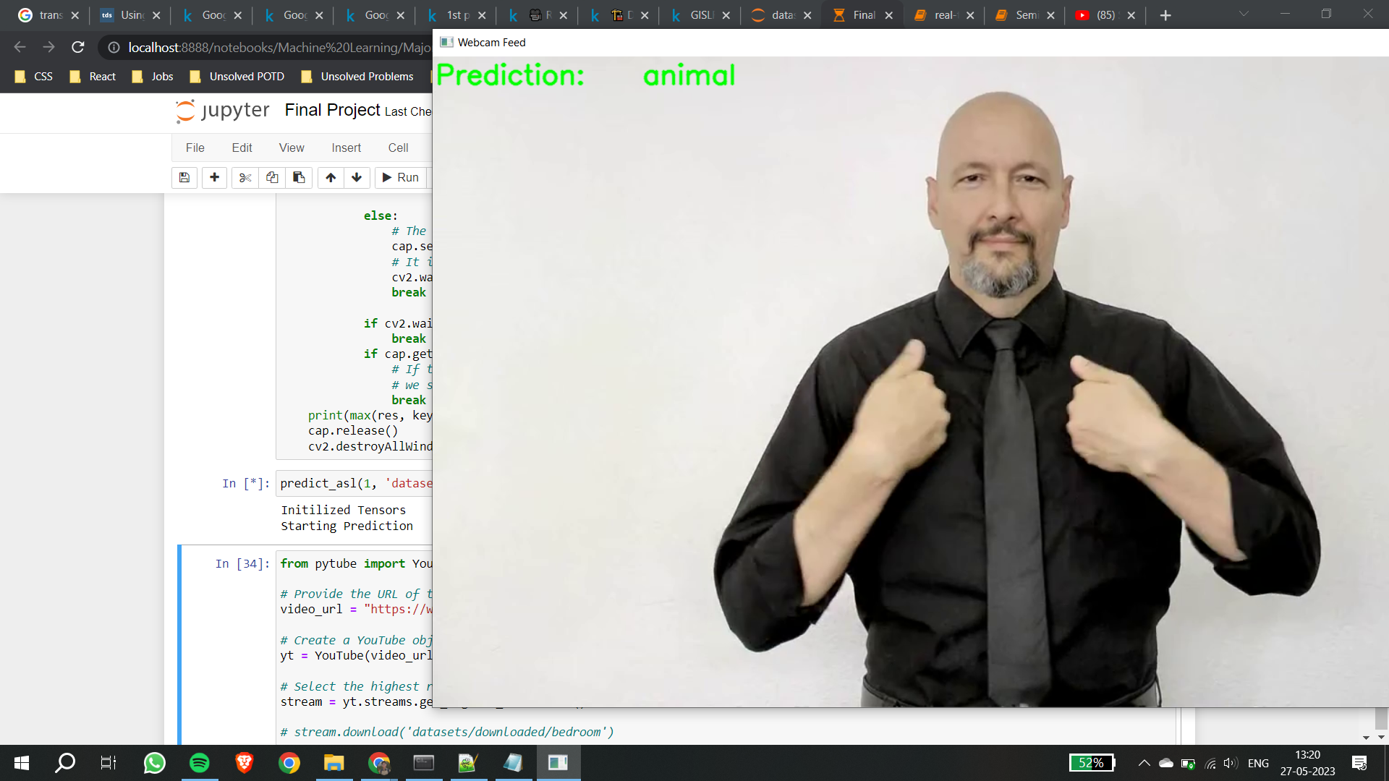
LIVE DEMO

Slide 14
CONCLUSION
The Sign Language Recognition(SLR) System has demonstrated significant advancements in ASL recognition, but there is still much work to be done. With continued research and development, we can expect to see further improvements in the accuracy and robustness of ASL recognition systems, ultimately enhancing communication and inclusivity for the ASL community.

Slide 15
T
H
A
N
K
Y
O
U

